Slide 1

Fast-Track your EKS setup with Amazon EKS Blueprints
EKS’press Lane to seamless EKS deployment
Saifeddine RAJHI
Senior Data Platform engineer
AWS community builder

Slide 2
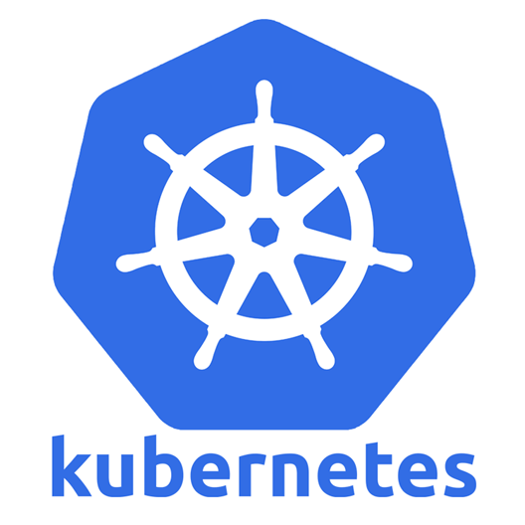
Introduction to Kubernetes (K8s)
What is Kubernetes?
An open-source container orchestration platform.
Automates deployment, scaling, and management of containerized applications.

Slide 3
Key Features:
Self-healing: Automatically restarts failed containers.
Horizontal Scaling: Easily scale applications up or down.
Service Discovery & Load Balancing: Distributes network traffic to ensure stability.
Automated Rollouts & Rollbacks: Manages updates and rollbacks seamlessly.
Why Use Kubernetes:
Simplifies complex container management.
Enhances application reliability and scalability.

Slide 4
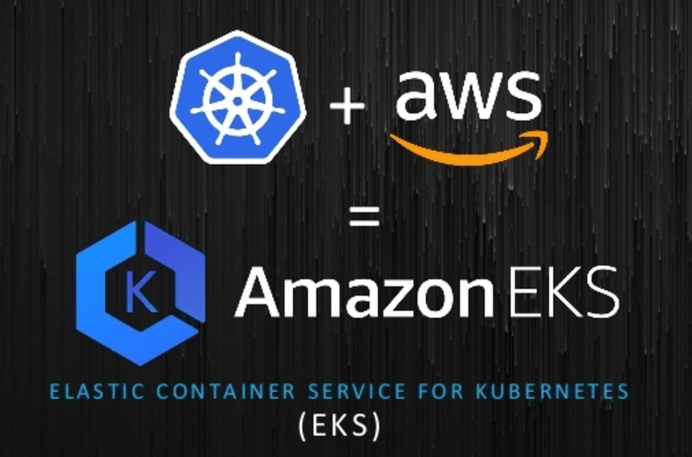

Slide 5
Amazon EKS
A managed Kubernetes service by AWS.
Simplifies running Kubernetes on AWS without needing to install and operate your own Kubernetes control plane or nodes.

Slide 6
Motivations Behind EKS Blueprints:
Challenges:
Building a tailored EKS cluster involves integrating various open-source tools and AWS services.
Requires deep expertise in both AWS and Kubernetes.
Managing workloads from multiple teams in the same cluster adds complexity.
Ensuring consistency and standardization across multiple EKS clusters can be challenging.

Slide 7
Customer Needs:
AWS customers seek examples demonstrating how to integrate Kubernetes tools.
Desire for easy provisioning of complete, opinionated EKS clusters that meet specific application requirements.
Preference for using familiar tools like Terraform, CDK, and Helm to manage the lifecycle of EKS clusters and the operational software within them.

Slide 8
Solution:
EKS Blueprints were created to address these needs.
They provide pre-configured templates to simplify and accelerate the setup of EKS clusters.
Help ensure consistency, standardization, and ease of management across multiple clusters.

Slide 9


Slide 10
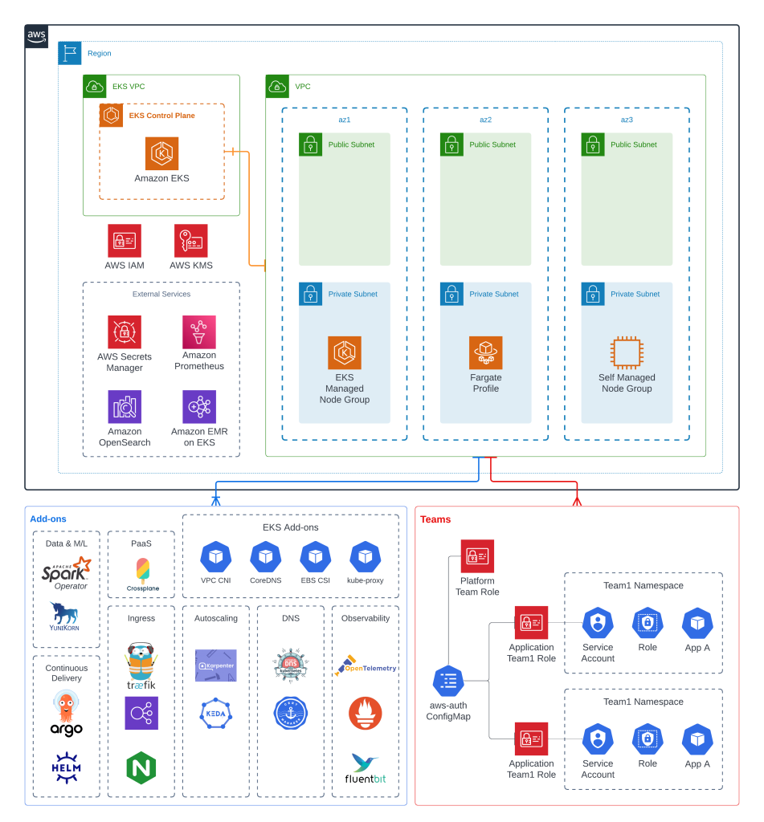

Slide 11
Benefits of EKS Blueprints
Quick Deployment:
Simplifies EKS cluster setup with pre-configured IaC modules.
Ensures fast and consistent deployment across accounts and regions.
Improved Security:
Easily integrates security controls.
Manages multi-team workloads.
Supports popular add-ons like Prometheus, Karpenter, Nginx, Traefik, AWS Load Balancer Controller, Fluent Bit, Keda, Argo CD, Cluster Autoscaler, Metrics Server, Calico, App Mesh Controller, AWS CloudWatch Metrics, AWS OpenTelemetry Collector, and AWS Cert Manager.

Slide 12

Implementation:
EKS Blueprints is implemented in two popular IaC frameworks: HashiCorp Terraform and AWS Cloud Development Kit (AWS CDK).
Automates infrastructure deployments.
To get started, visit the Getting Started guides for either EKS Blueprints for Terraform or EKS Blueprints for CDK.

Slide 13
Infrastructure as Code (IaC):
IaC is the practice of managing and provisioning computing infrastructure through machine-readable definition files, rather than physical hardware configuration or interactive configuration tools.
Automates the setup, management, and teardown of infrastructure, reducing manual effort and minimizing errors.
Ensures that the same environment is provisioned every time, which is crucial for development, testing, and production.
Easily replicate environments across different regions or scales, supporting rapid deployment and scaling.

Slide 14
EKS Blueprints:
EKS Blueprints Overview: AWS Blog
Terraform:
EKS blueprints for terraform: GitHub Repository
EKS blueprints Add-ons for terraform: GitHub Repository (behind the scene it uses EKS blueprints Add-on module)
EKS Karpenter blueprints: GitHub Repository
AWS CDK:
EKS Blueprints for CDK: GitHub Repository

Slide 15

Saifeddine RAJHI
Senior Data Platform engineer
AWS community builder

Slide 16
Resources:
https://aws-quickstart.github.io/cdk-eks-blueprints/
https://aws.amazon.com/blogs/containers/bootstrapping-clusters-with-eks-blueprints/
https://aws-ia.github.io/terraform-aws-eks-blueprints/getting-started/
https://aws.amazon.com/blogs/containers/tag/eks-blueprints/
https://aws-ia.github.io/terraform-aws-eks-blueprints-addons/main/

